Slide 1
Crash Course in Cloud Security

Slide 2
Agenda Demo
What is the Cloud?
Cloud Security Basics
Shared Responsibility
IAM
APIs
Best Practices
Network Security
Infrastructure as Code
Policy as Code
Continuous Integration and Continuous Deployment (CI/CD)

Slide 3

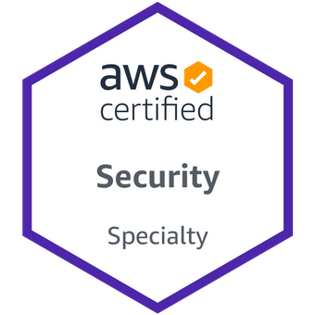
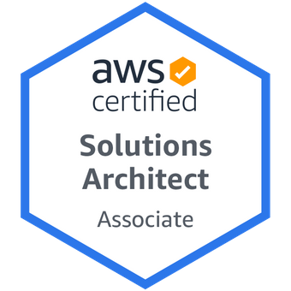
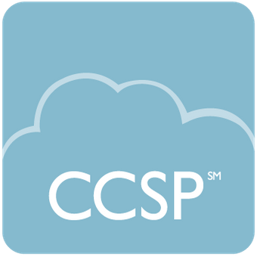
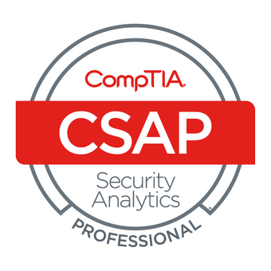
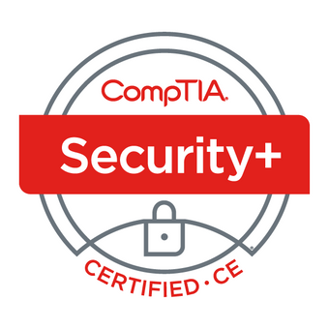
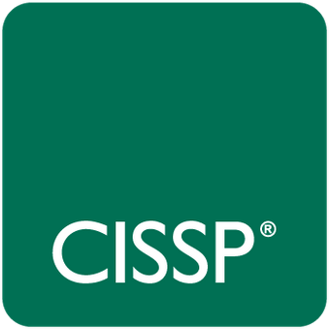
whoami
Cloud Security Engineer at Booz Allen Hamilton
Auburn University Graduate:
Masters in Cybersecurity Engineering
Bachelors in Software Engineering
Former Auburn EHC Member and GTA

Slide 4
What is the Cloud?

Slide 5
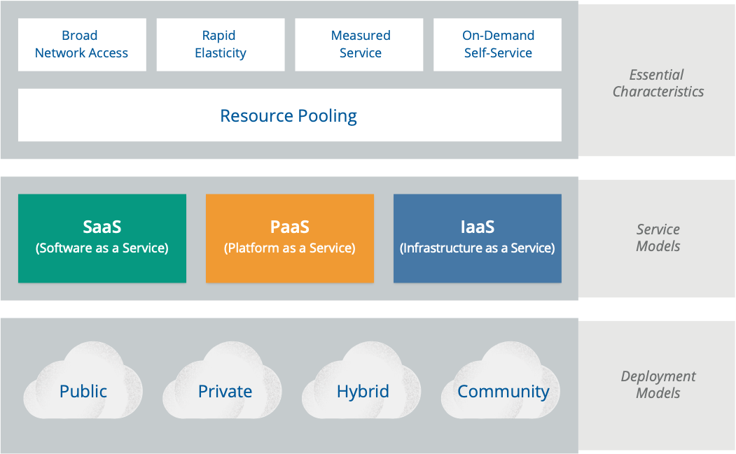
Characteristics of Cloud Computing

Slide 6
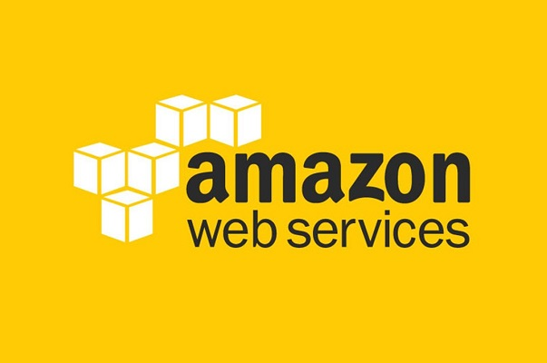
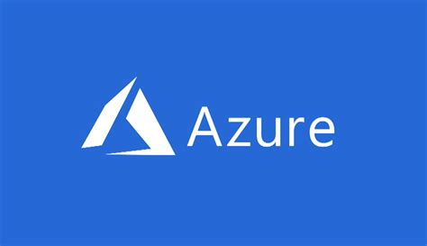
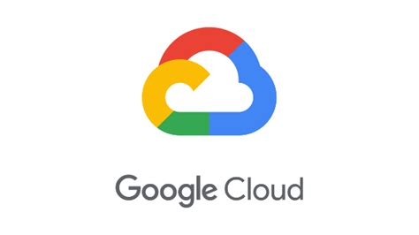
Characteristics of Cloud Computing
Broad network access
On-demand self-service
Resource pooling
Rapid elasticity
Measured Services

Slide 7
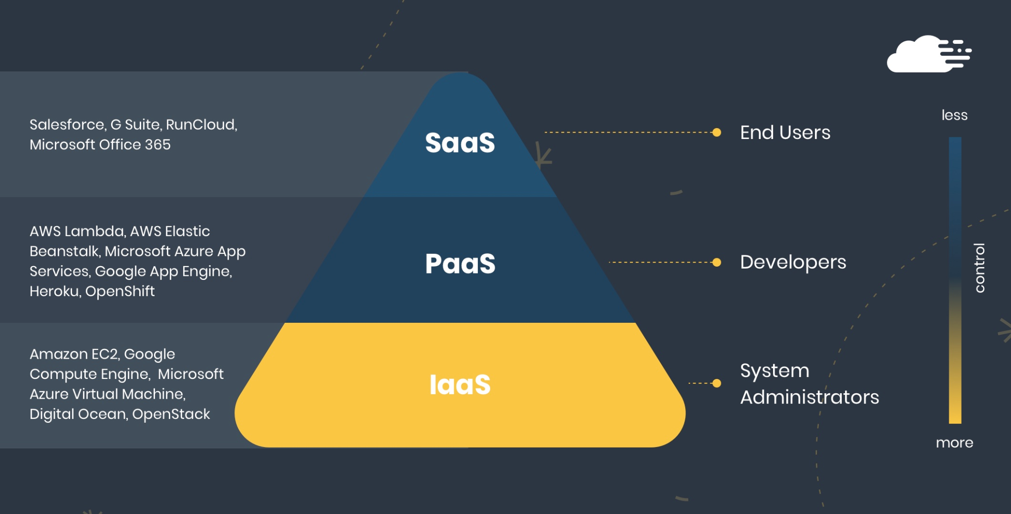
Service Models

Slide 8
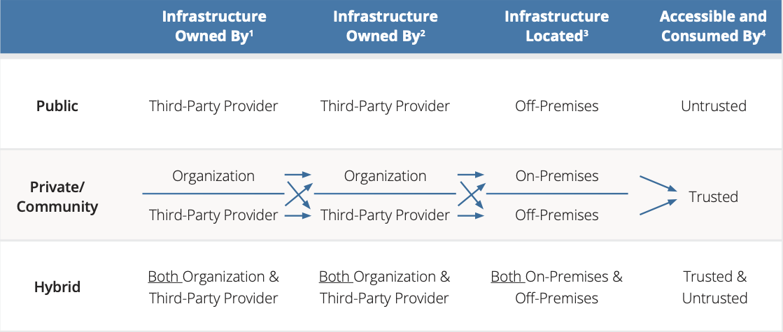
Deployment Models

Slide 9
Benefits of Cloud Computing
No need to run and maintain data centers
Trade upfront expense for variable expense
Stop guessing computing, networking, and storage requirements
Benefit from economies of scale
Increased speed, agility, and elasticity
Go global in minutes

Slide 10
Disadvantages of Cloud Computing
Vendor Lock-in
Integration with Existing Architecture
Data Governance and Sovereignty
Privacy and Security Risks
Skills Gap

Slide 11
Cloud Security Basics

Slide 12



Cloud Security Made Simple
Shared Responsibility Integrated Identity API Coverage

Slide 13
The Goal of Cybersecurity
Make sure that systems work as intend
…..and only as intended

Slide 14



Nation State
Insiders

Slide 15



Cybercriminals
Misconfigurations

Slide 16
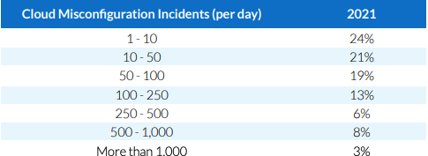
Cloud Security is Configuration Security
“Misconfigurations represent the number one risk for every organization using the cloud. 36% of cloud professionals say their organization has experienced a serious cloud data leak or a breach in the past 12 months. More than 8 out of 10 are worried that they are vulnerable to a major data breach related to cloud misconfiguration.” - Fugue State of Cloud Security 2021

Slide 17
Learn from Others

Slide 18
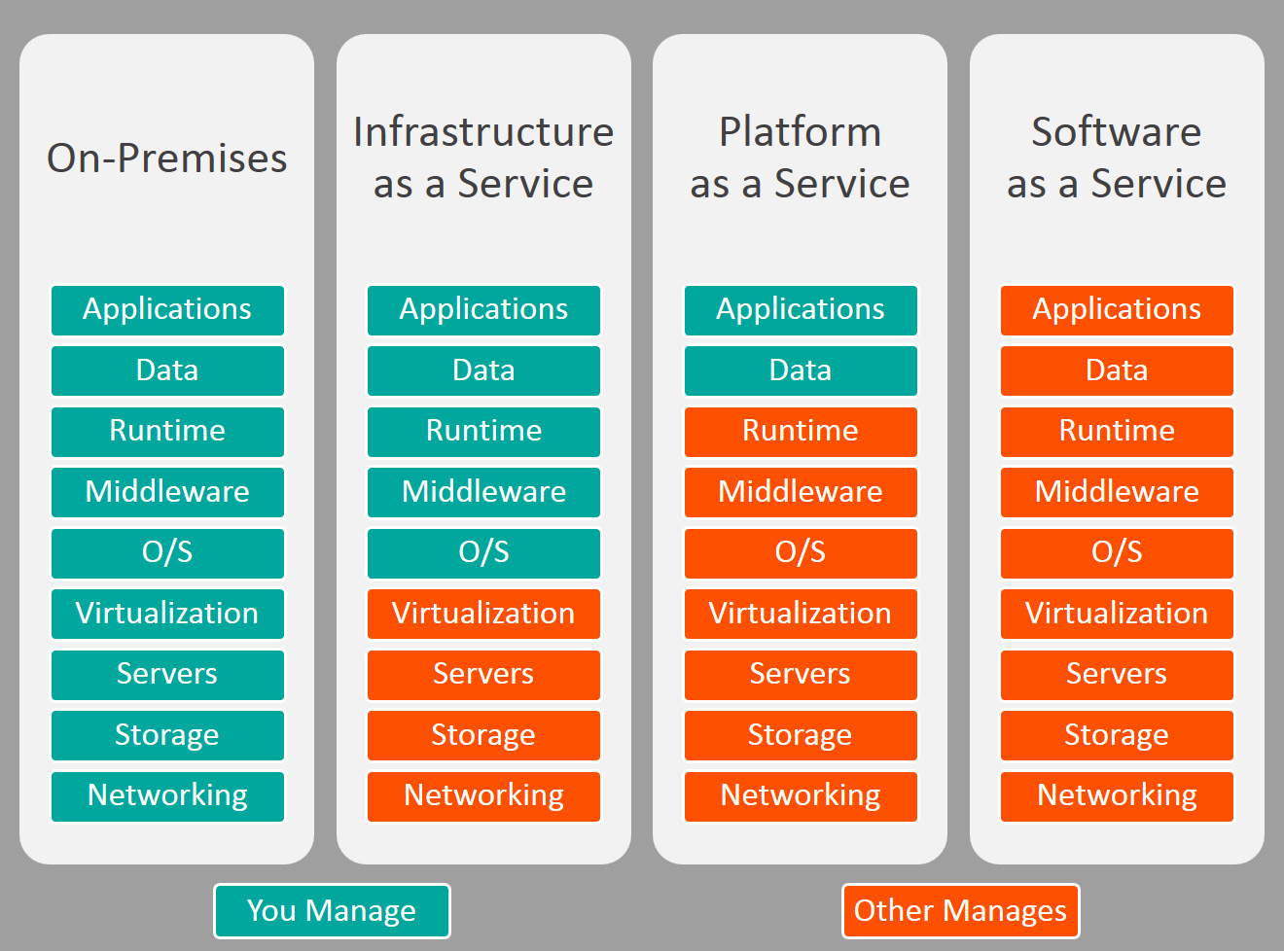
Shared Responsibility Model

Slide 19

Adoption Framework
Map business processes
Identify stakeholders
Make an action plan

Slide 20

CIS Foundations
Prescriptive Guidance
Strong Baseline
Checklist of tasks

Slide 21
What happened?

Slide 22

Logging and Monitoring
AWS CloudTrail
Azure Monitor
Google Cloud Operations Suite
What happened in my account?
Who or what made it happen?

Slide 23
Who’s there?

Slide 24
Identity
AWS IAM
Azure IAM
Google Cloud IAM
Who are you?
What are you allowed to do?

Slide 25
Areas of Focus

Slide 26

Network
Maximize native cloud structures
VPCs/Virtual Networks as strong boundaries

Slide 27

Compute
Know the responsibility line
Harden the OS/Service
Fix issues in the build pipeline

Slide 28
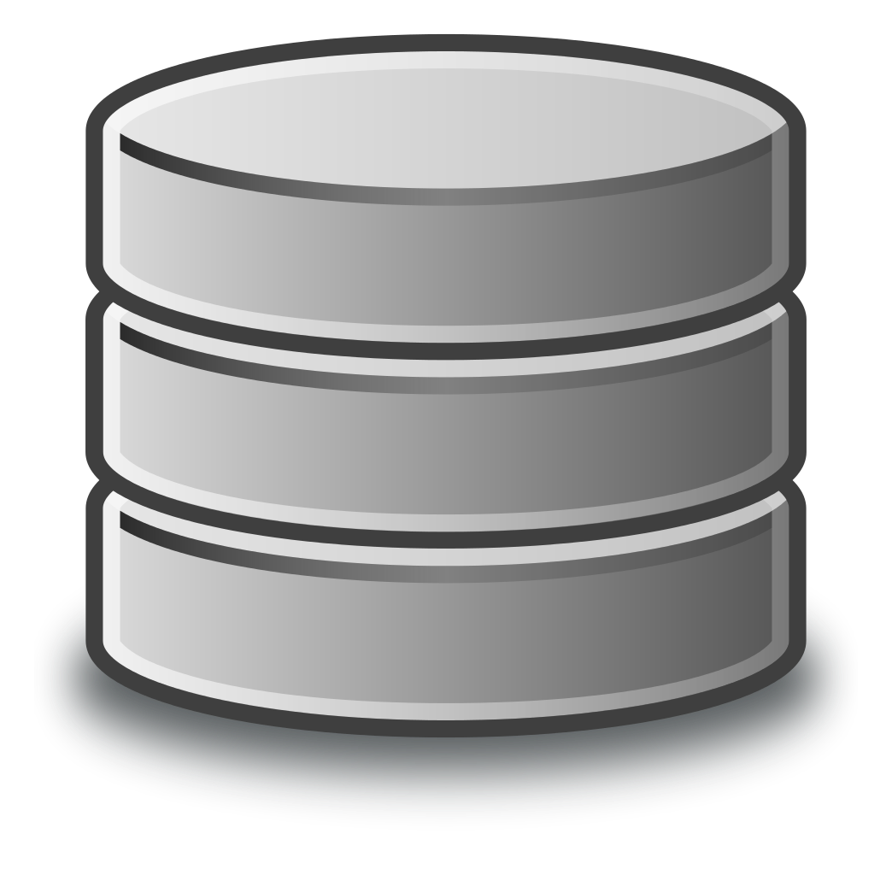
Data and Storage
Encrypt at rest and in-transit
IAM as granular as possible
Lifecycle strategies to control costs

Slide 29
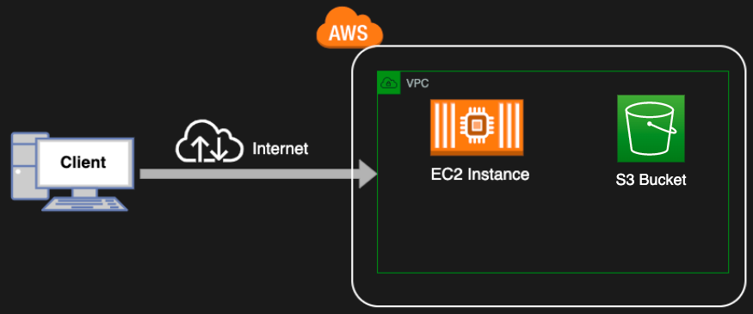
Demo
Demo

Slide 30
Problems
Not scalable for large tasks
Misconfigurations are easy as one missed button press could lead to catastrophic results
No way to manage or test new or current infrastructure
Difficult to audit changes over time

Slide 31
Jenkins Overview
Open-source automation server used to automate parts of the SDLC
It helps software teams facilitate Continuous Integration and Continuous Delivery (CI/CD)
Highly customizable with hundreds of plugins available

Slide 32
Why do we need Jenkins?
Developers making code changes in parallel want to make sure that their code changes integrate without errors
Manual integration testing is time-consuming and error-prone
Build and test changes in standardized environment

Slide 33
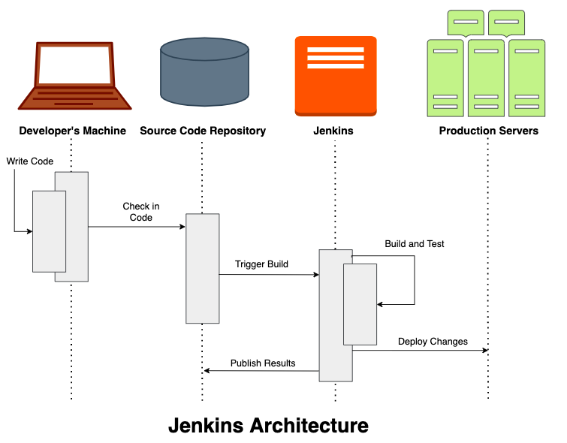

Slide 34
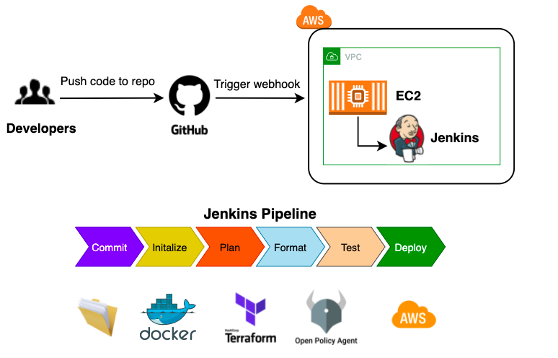
Demo

Slide 35
Best Practices
Establish visibility and tag all resources
Turn on encryption where possible
Lock down access policies by applying least privilege practices and leveraging native cloud solutions
Infrastructure as Code wherever possible
Use policy-based automation wherever possible

Slide 36
Resources
Rhino Labs: Pentesting Reports and tools including: Cloudgoat, Pacu, CloudScraper, CCAT
https://rhinosecuritylabs.com/resources/
https://github.com/RhinoSecurityLabs
Summit Route: AWS Security Maturity Roadmap 2021, CTF for common AWS mistakes
https://summitroute.com/blog/2021/01/12/2021_aws_security_maturity_roadmap_2021/
http://flaws.cloud/
http://flaws2.cloud/
Fugue: Engineer’s Primer on Cloud Security, State of Cloud Security 2021
https://www.fugue.co/resources-library#section-whitepapers-&-reports
Cloud Security Alliance: Security Guidance for Critical areas of Focus in Cloud Computing
https://cloudsecurityalliance.org/research/guidance

Slide 37
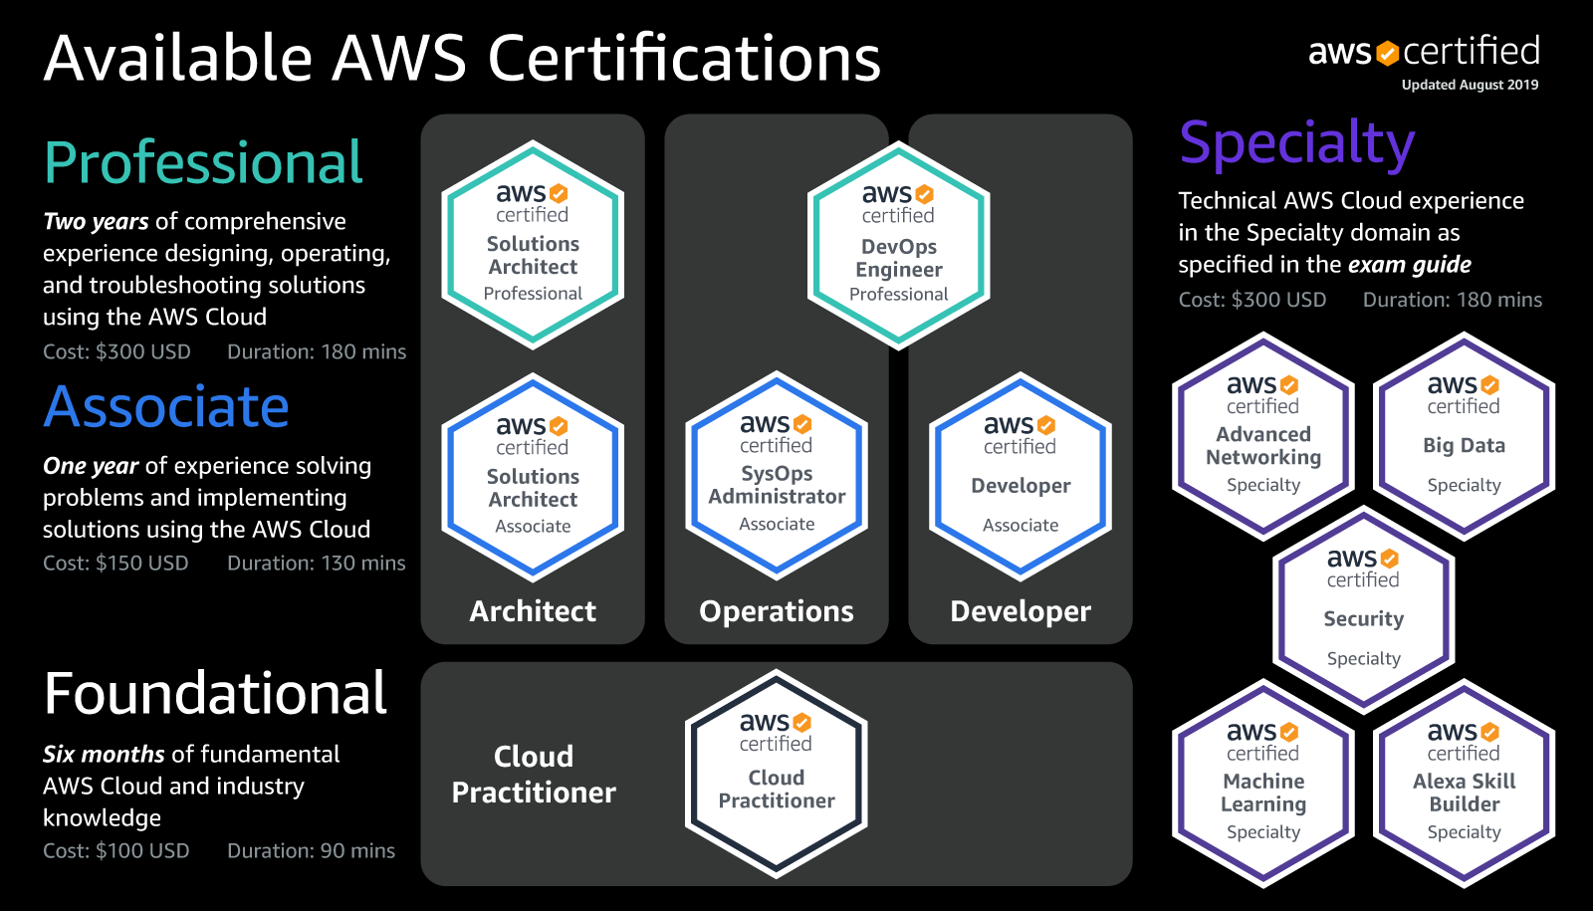
Resources
Resources

Slide 38

Resources
LinkedIn: https://linkedin.com/in/john-david-watts-4424b2132
Email: jdw0069@auburn.edu
Discord: John David (Yeti)#6184
Github: https://github.com/jdw0069

Slide 39
Questions?

